Slide 1
Sparse Nonlinear Optimizer Profile
(SNOPT)
Tom McElrath

Slide 2
Outline
STK Use Case
  SNOPT Targeting Profile
  Tips and Tricks
SNOPT Lunar Trajectory

Slide 3
STK Use Case
SNOPT Targeting Profile

Slide 4
SNOPT Targeting Profile
The Three Key Tabs
Variables
Options
Log

Slide 5
Variables
Two Main Sections
  Decision Variables (Controls)
  Objectives and Constraints (Results)

Slide 6
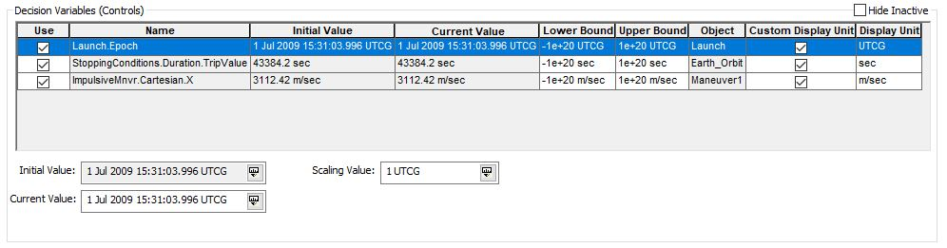
Decision Variables (Controls)
Key Takeaway
The upper and lower bounds can be changed if the user wants to further constraint SNOPT. This will help with convergence.

Slide 7
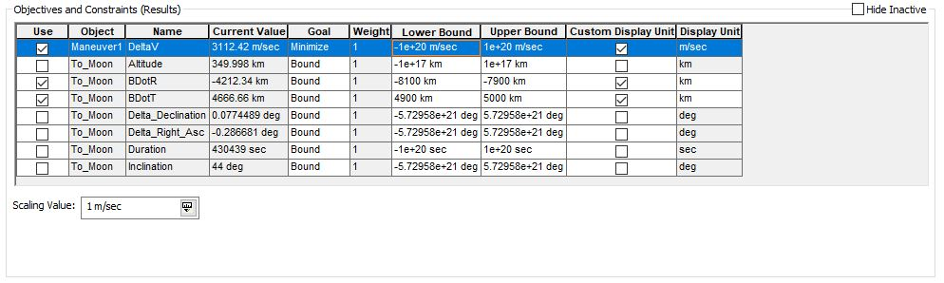
Objectives and Constraints (Results)
Key Takeaway
If the goal is changed to minimize, SNOPT will ignore the bounds, and change the controls, in order to make the selected result as small as possible. In order to maximize a result, the weight needs to be changed from 1 to -1.

Slide 8
Options
Two Main Sections
  Iteration Limits and Tolerances
  SNOPT Option Specifications File

Slide 9
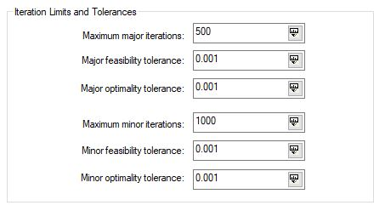
Iteration Limits and Tolerances
Key Takeaway
The value for both iterations and tolerances is dependent on the problem the user is trying to solve, and if one set of values is not converging, then they can always be changed to better suit the problem at hand.

Slide 10
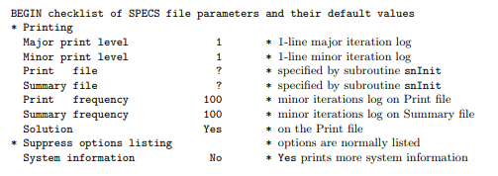
SNOPT Option Specifications File
Key Takeaway
These files are used to further customize the SNOPT options beyond the iteration and tolerance values. Any number of options can be used in a file, so the user can write a file using only desired options.

Slide 11
Log
Six Main Sections
  Parameters
  Matrix Statistics
  Major Iteration Log
  Exit Summary
  Constraints
  Variables

Slide 12
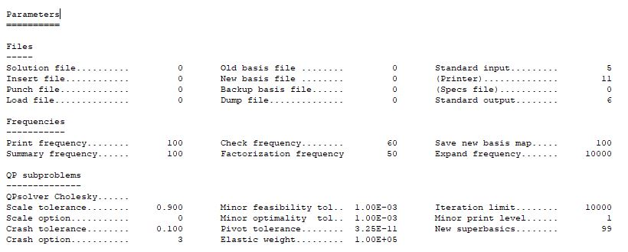
Parameters
This section displays all of the specification options, and their values, that were used by SNOPT.

Slide 13
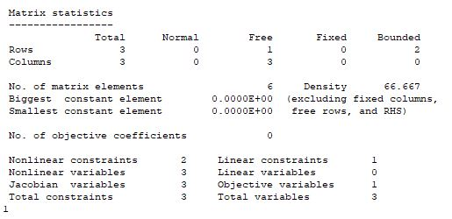
Matrix Statistics
This section displays the number of nonlinear constraints, nonlinear variables, linear constraints, and linear variables, along with other matrix information.

Slide 14
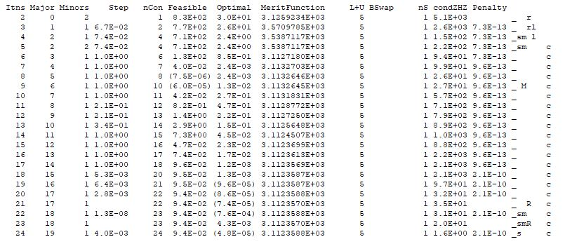
Major Iteration Log
This section displays information regarding the step size, feasibility, and optimality, as a function of cumulative minor iterations.

Slide 15
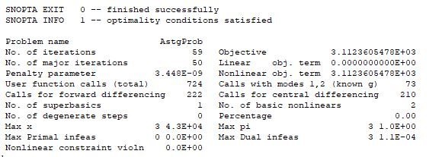
Exit Summary
This section provides the SNOPT exit condition and information, as well as the number of iterations and the value of the objective.

Slide 16
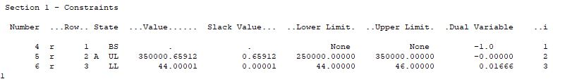
Constraints
This section displays information regarding the state, value, and upper and lower bounds of the constraints in the problem.

Slide 17
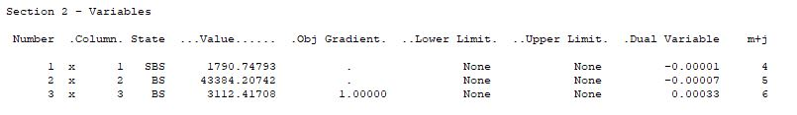
Variables
This section displays information regarding the state, value, and upper and lower bounds of the variables in the problem.

Slide 18
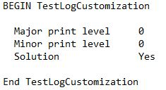
Log Customization
Key Takeaway
It is possible for a user to create a log that displays user specified information, which is done by creating a custom options file. A sample file is shown below.
Parameters 
Matrix Statistics 
Major Iteration Log 
Exit Summary  Constraints 
Variables 

Slide 19
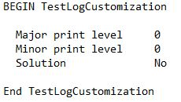
Log Customization
Parameters 
Matrix Statistics  Major Iteration Log 
Exit Summary  Constraints 
Variables 

Slide 20
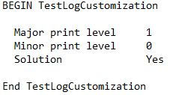
Log Customization
Parameters 
Matrix Statistics  Major Iteration Log 
Exit Summary  Constraints 
Variables 

Slide 21
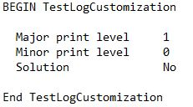
Log Customization
Parameters 
Matrix Statistics  Major Iteration Log 
Exit Summary  Constraints 
Variables 

Slide 22
STK Use Case
Tips and Tricks

Slide 23
Tips and Tricks
The Five Key Guidelines
  Local Optimality
  Constraints
  Major vs. Minor
  Scaling
  Epoch Control

Slide 24
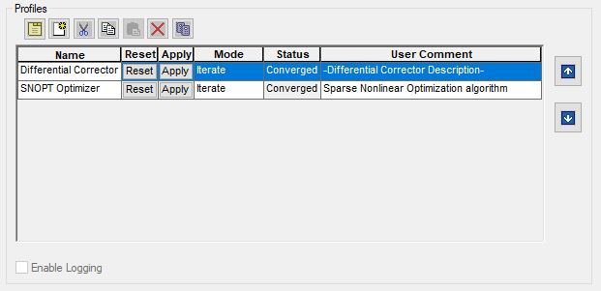
Local Optimality
The SNOPT targeting profile is built to find locally optimal solutions.
Run a Differential Corrector profile first, so SNOPT is given an accurate initial guess.

Slide 25
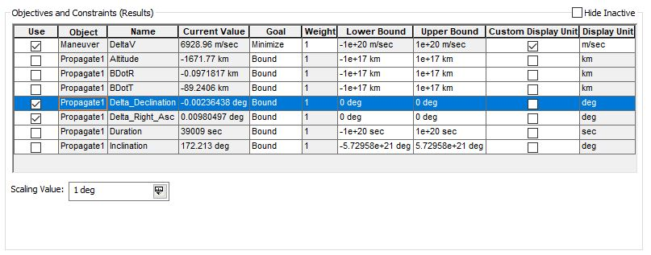
Constraints
SNOPT runs better if there are more constraints.
Set the lower and upper bounds equal to each other. User should go to the options tab and increase the tolerance values instead of changing the constraint bounds.

Slide 26
Major vs. Minor
Major deals with each overall problem iteration. (Accuracy of solution)
Minor deals with the search direction towards the next overall problem iteration. (Accuracy of next iteration)

Slide 27
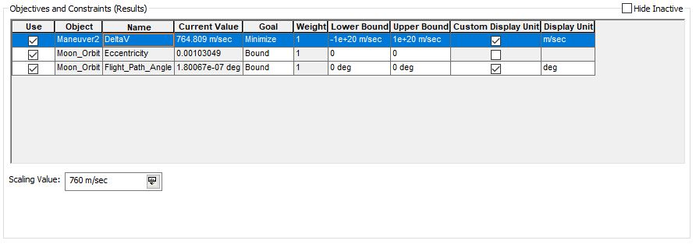
Scaling
Use if the parameters in a SNOPT profile have very different magnitudes.
Current value is divided by scaling value to pass unit-less value on to SNOPT.
Goal is to get each result close to one.

Slide 28
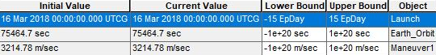
Epoch Control
SNOPT recognizes numerical values in the bound fields and not specific dates.
Use any of the epoch units: EpSec, EpMin, EpHr, EpDay, or EpYr.
Each unit represents the time ahead of, or behind, the given initial value

Slide 29
SNOPT Lunar Trajectory

Slide 30
SNOPT Lunar Trajectory
The Six Mission Highlights
  Mission Outline
  Differential Corrector
  SNOPT Minimum Delta-V
  SNOPT Minimum Time
  Results
  Future Research

Slide 31
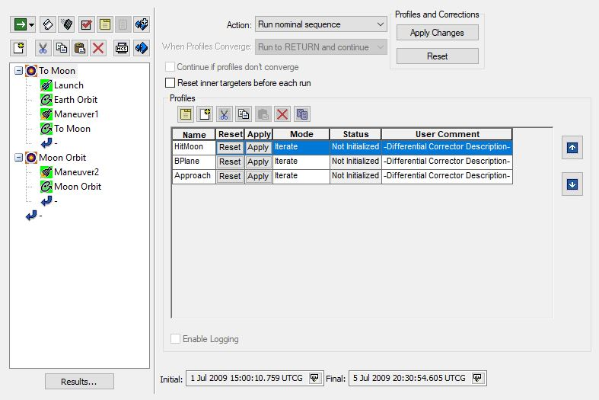
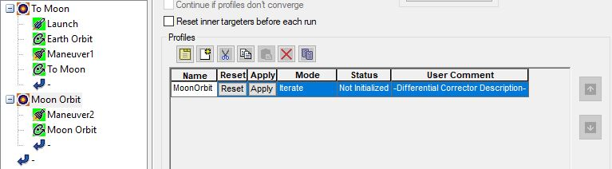
Mission Outline
Spacecraft launched from Cape Canaveral into Earth orbit, underwent an impulsive maneuver to reach the Moon, and then entered lunar orbit.
Goal to show how SNOPT can be used to optimize deep space missions.

Slide 32
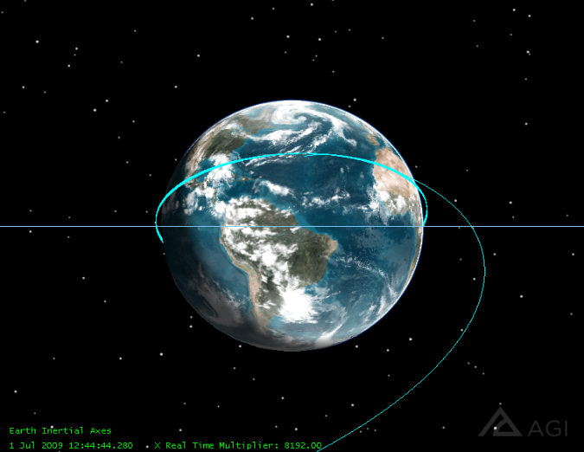
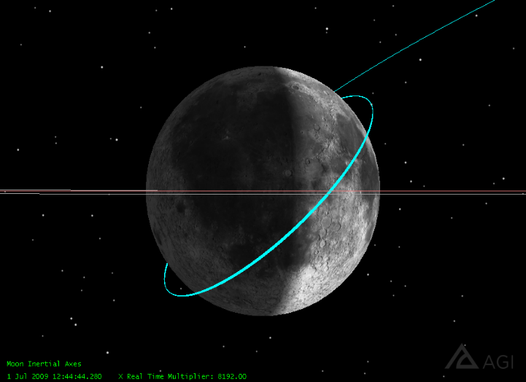
Differential Corrector
Differential Corrector trajectory between Earth and the Moon

Slide 33
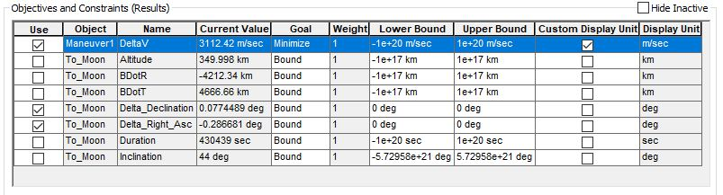
SNOPT Minimum Delta-V
Differential Corrector Spacecraft was copied and pasted into the object browser.
Differential Corrector profiles were replaced with SNOPT profiles.
Delta-V results were added to both maneuver segments and minimized.

Slide 34
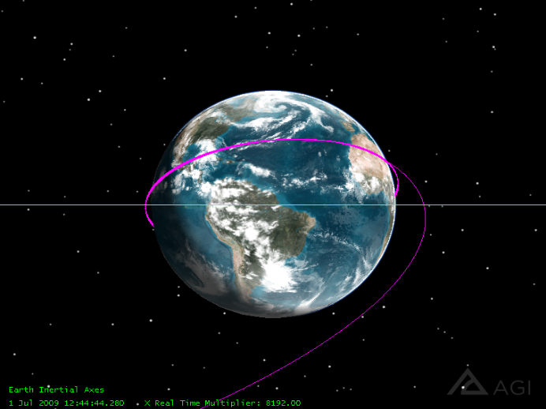
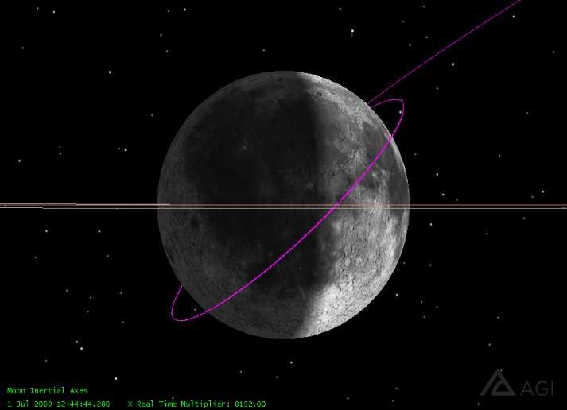
SNOPT Minimum Delta-V
Optimized trajectory for minimum total delta-v between the two maneuvers

Slide 35
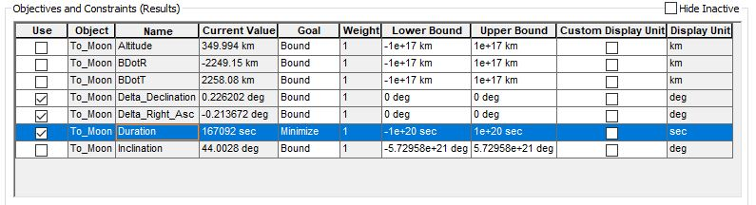
SNOPT Minimum Time
Differential Corrector Spacecraft was copied and pasted into the object browser.
Differential Corrector profiles were replaced with SNOPT profiles.
Duration result was added to the To Moon propagate segment and minimized.

Slide 36
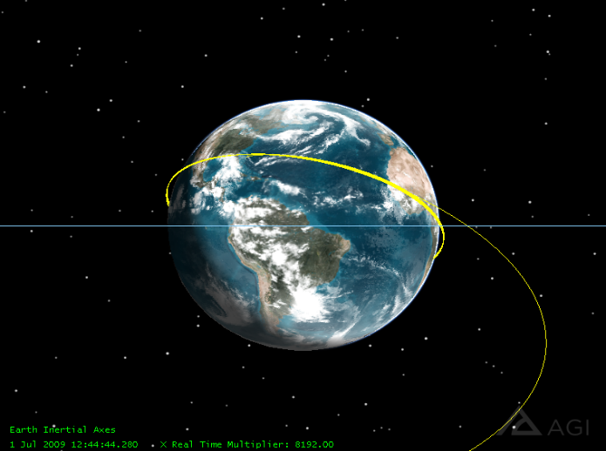
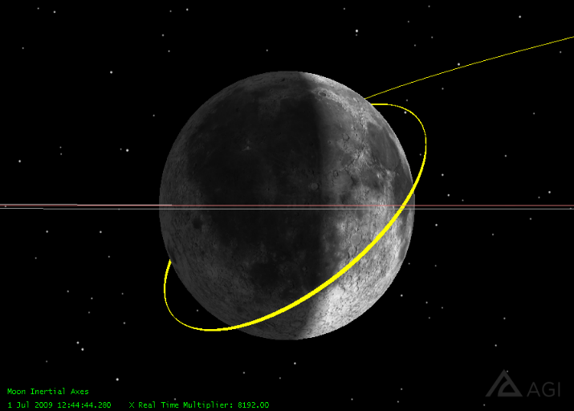
SNOPT Minimum Time
Optimized trajectory for minimum travel duration between Earth and the Moon

Slide 37
Results
SNOPT_DeltaV Spacecraft had the lowest total Delta-V of 3877.22 m/sec.
  Saved about 61 m/sec of total Delta-V
SNOPT_Time Spacecraft had the lowest duration value of 46.41 hours.
  Saved about 43 hours of travel time from the Earth to the Moon.

Slide 38
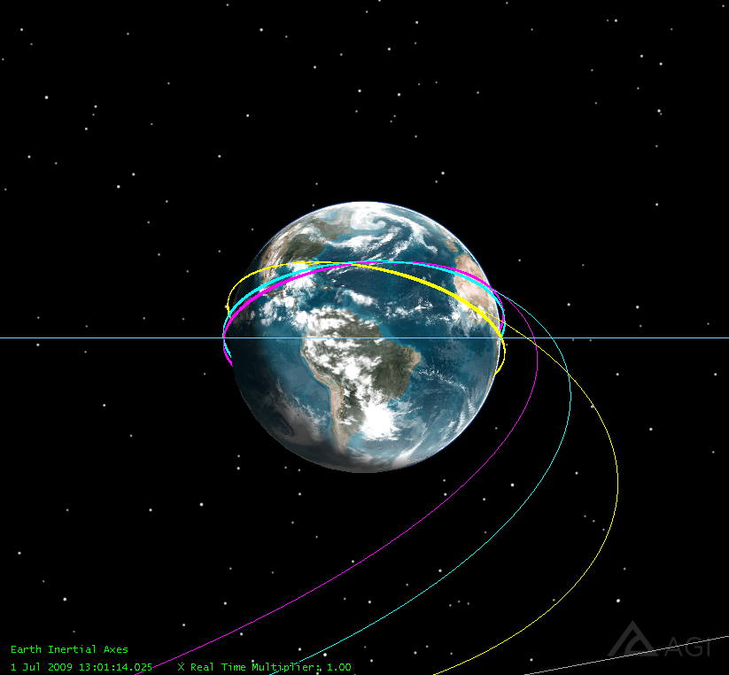
Earth View

Slide 39
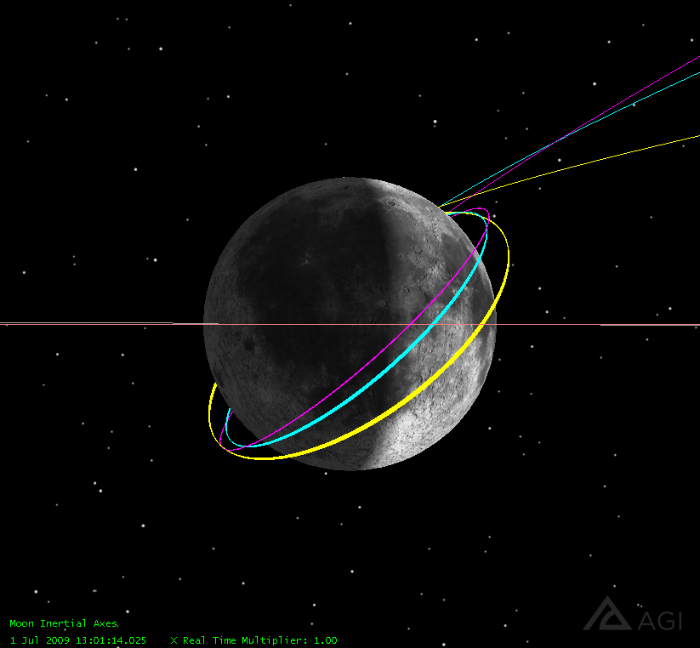
Moon View

Slide 40
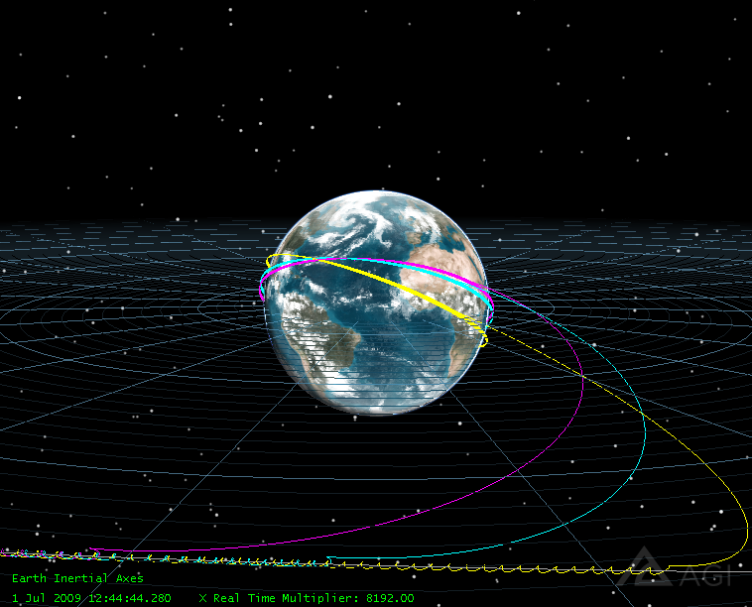
Earth View with ECI Grid

Slide 41
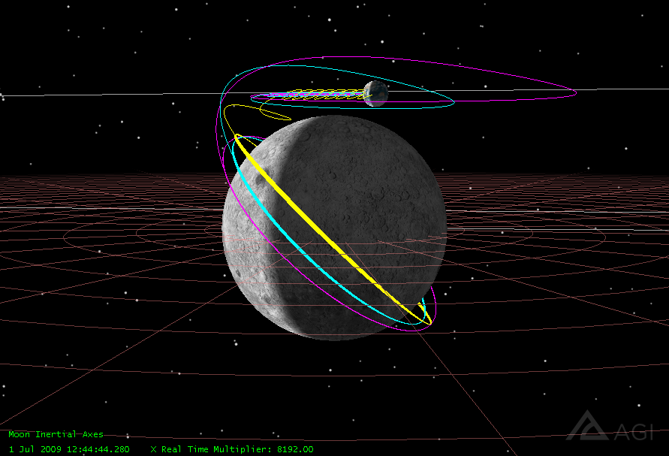
Moon View with CBI Grid

Slide 42
Future Research
Run this lunar trajectory and target different constraints such as mean eccentricity and signed eccentricity instead of eccentricity.
Run this lunar trajectory with IPOPT profiles
Run this lunar trajectory with different propagators such as point mass, J2, and J4.

Slide 43
References
P. E. Gill, W. Murray, M. A. Saunders, and E. Wong.
User’s Guide for SNOPT Version 7.6: Software for Large-Scale Nonlinear Programming∗.
Jan. 2017, www.sbsi-sol-optimize.com/manuals/SNOPT Manual.pdf.
“Sparse Nonlinear Optimizer (SNOPT) Profile.”
Analytical Graphics Inc., July 2018,
help.agi.com/stk/11.4.0/index.htm#gator/ab-SNOPTprofile.htm#Var.
Special thanks to….
Pradipto Ghosh, Cody Short, Austin Claybrook, Kyle Kochel, Ethan Whitaker, John Thompson, Jens Ramrath, Kate Lane
…and the entire AGI team!

