Slide 1
**New in STK 12.4** Licensing Changes and what it means for you

Slide 2
Licensing Changes …
Beginning with STKv12.3 and ODTKv7.3, new licenses are required.
  New licensing service
  New licenses not backwards compatible, old licenses not forward compatible
  Scenarios are still forward compatible – this has not changed
All new licenses will be network
  No local/nodelock licenses
  Can install license service locally to serve a single user, or on a network to share licenses
  New (Ansys License Manager) and legacy (STK License Server) license services can be installed side-by-side – just need to use unique ports
  New licenses use same FlexNet as legacy licenses, so all the same rules apply such as setting up firewalls & using options files

Slide 3
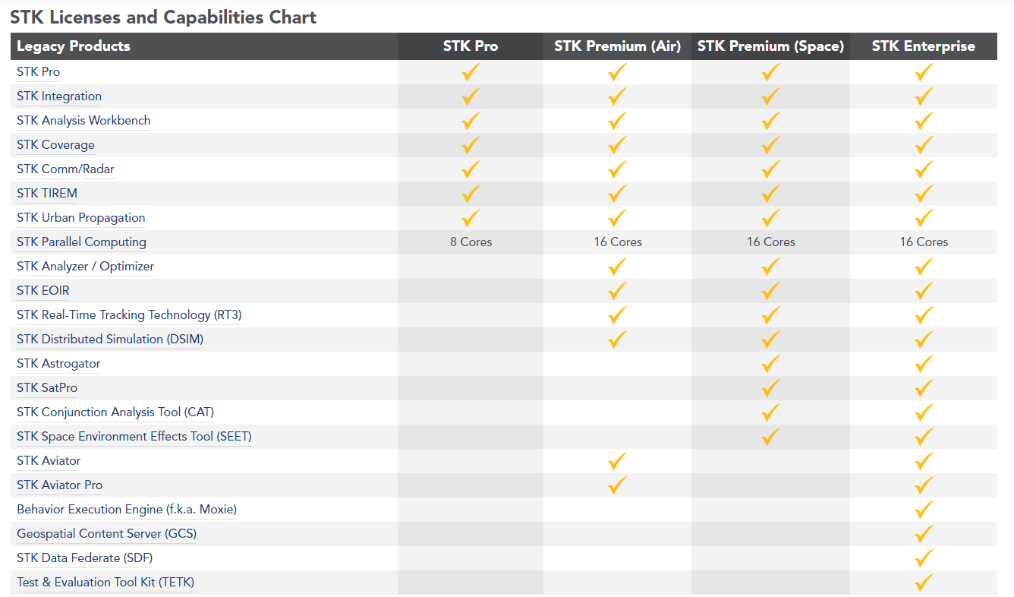
Licensing Changes …
Need to coordinate with account manager/renewal rep on license ‘migration’
Notes:
Need to coordinate with account manager/renewal rep on license ‘migration’

Slide 4
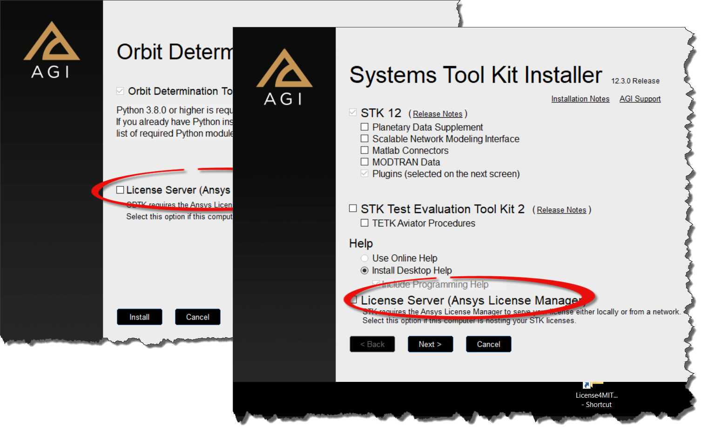
Here's How To Set Up A License Server:
1. Install the ANSYS License Manager. This is available from the main installation window.

Slide 5
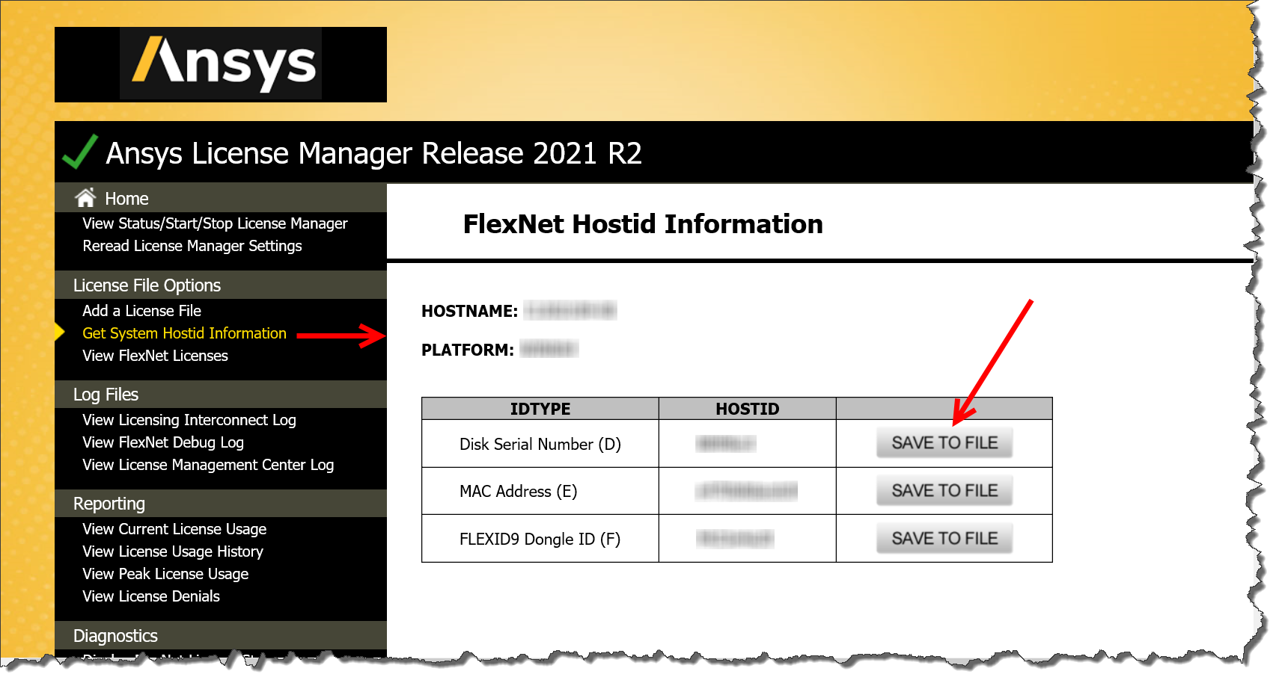
Here's How To Set Up A License Server:
2. Get a license file.
Find the Disk Serial Number or MAC Address and HOSTNAME from START –> ANSYS License Management Center -> License File Options -> Get System Hostid Information.

Slide 6
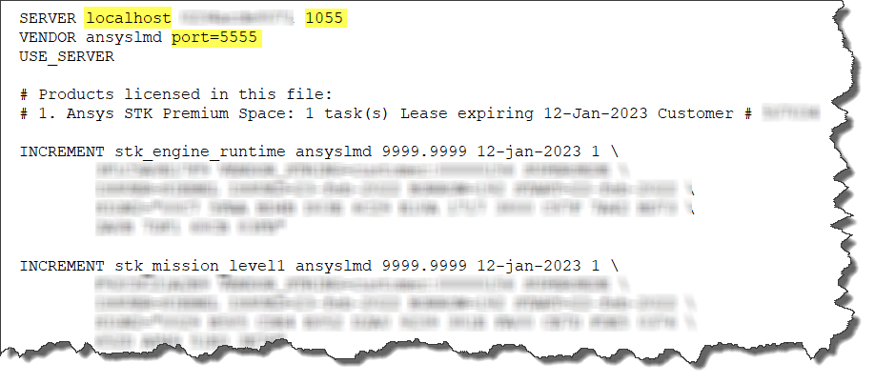
Here's How To Set Up A License Server:
3. Manually edit the license file, if needed.
SERVER <Hostname or IPAddress> <MAC or DISK ID> [TCP/IP port]
VENDOR ansyslmd [path to ansyslmd] [options="path to options file"] [port=daemon TCP/IP port]

Slide 7
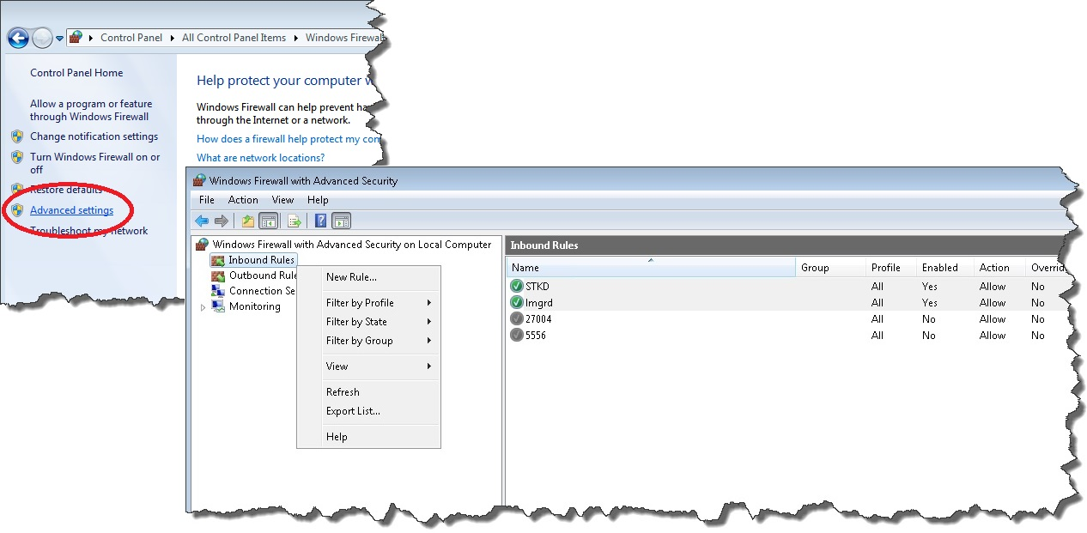

Here's How To Set Up A License Server:
4. The same firewall requirements as used with previous versions of STK still apply. You need to allow either the TCP ports or the lmgrd and ansyslmd (daemon) as exceptions.

Slide 8
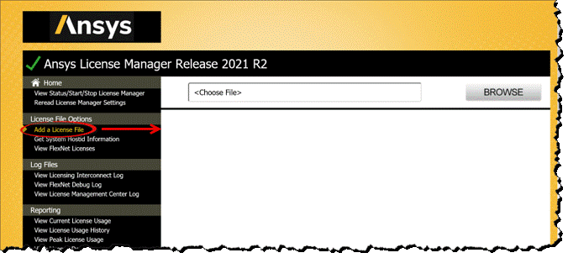
Here's How To Set Up A License Server:
5. Back in the ANSYS License Manager -> License File Options -> Add a License File, browse to and open your license file. This will automatically start the service. If not, you can do so from the Home -> View Status/Start/Stop License Manager page.
For Admins: license file will get resaved/renamed to here by default:
C:\Program Files\ANSYS Inc\Shared Files\Licensing\license_files\ansyslmd.lic

Slide 9
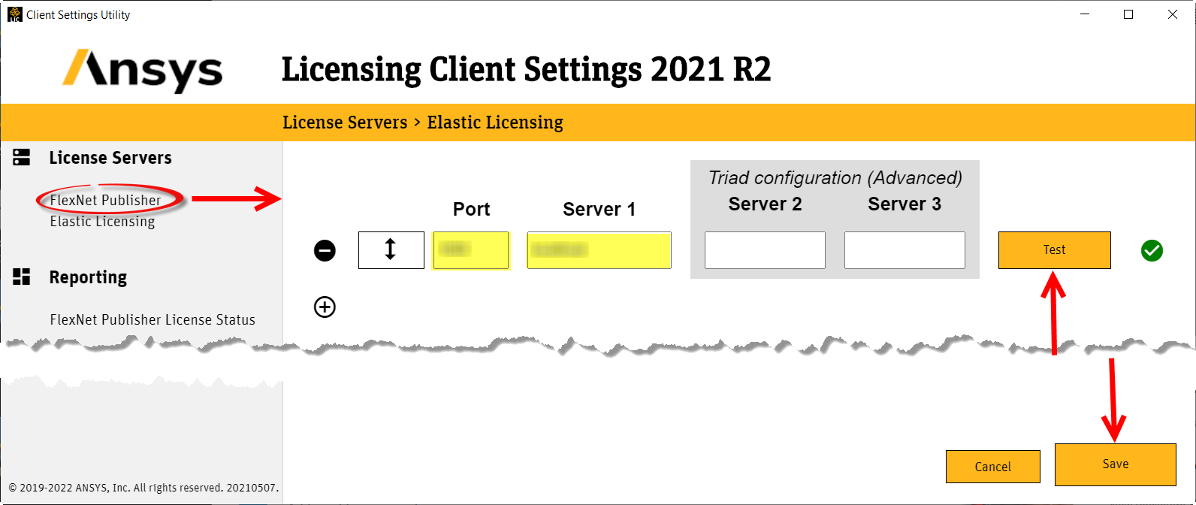
Point The Client To The License Server
You now need to point the client (STK, ODTK, etc) to the license server. Right-click on the START -> STK 12 or AGI ODTK7 -> STK Client License Settings and select to Run as administrator. Enter the Port and Server name (or IP address). Click Test, and if it passes (green checkmark) click Save. You can enter more than one server, and STK will attempt to check out a license from all of them in the order in which they are listed.

Slide 10
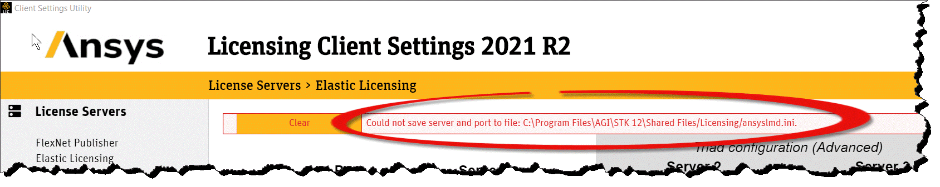
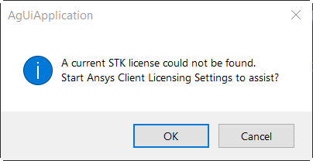
Common gotchas …
If you did not have permissions to Save you server info , you may see this error:
When starting up STK, if all licenses are in use, you will simple get a no license found pop-up

Slide 11
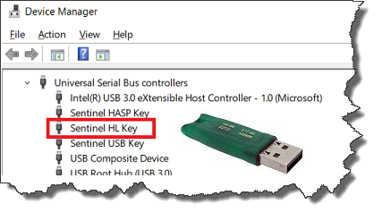
Deep Thoughts (and last slide !) …
You can still request eval licenses online: https://licensing.agi.com/stk/evaluation/
At this time, there is no ‘free’ version of STK (need to stick w/STKv12.2 for this)
Licenses are not tied to a version, they are tied to a maintenance end date or expiration date
STK still has the requirement that only 1 instance of a major version can be installed (this has not changed)
Only dongle supported is the Aladdin Hasp HL (green/usb)
No more local license excludes (exclude files)
Current license usage can be shown in Ansys Lic Manager as well as the Client Settings tool

